Slide 1

Social and Emotional Learning:
An Introduction
[Date]
Presenter:

Slide 2

Welcome
Notes:
Take a few minutes for a Welcoming Ritual appropriate for the group and time available. This can be as simple as Turn to Your Partner and asking “What’s New?” or another activity to bring the participants into the space ready to learn about SEL. Additional suggested activities are available in the SEL 3 Signature Practices Playbook:
https://schoolguide.casel.org/uploads/2018/12/CASEL_SEL-3-Signature-Practices-Playbook-V3.pdf
Why do a welcoming activity that focuses on learning new ideas? Participants arrive with a wide range of understanding of SEL and you want to create an environment in which it is safe to not know much about the topic. You also want to connect people to one another to reduce their anxiety and create a sense of belonging.

Slide 3
Guiding Questions:
What is SEL?
Why does SEL matter?
How can schools promote SEL for students?
Notes:
1 minute
These will be the questions that we will be looking at together. (Decide if you want to take participant questions along the way or at the end of the presentation and let participants know). If participants ask questions that you don’t have an answer for record it and get back to them asap.

Slide 4

What are your hopes and dreams for your child or the children in our community?
Notes:
6 minutes
(30 sec)Invite participants to jot down 1 or 2 hopes/dreams .
(5.5 min) Ask them to turn to nearby partner and share and then listen. Ask folks to popcorn out what pairs shared - record on chart. In order to learn new ideas people need to care about it - it needs to be personal.

Slide 5
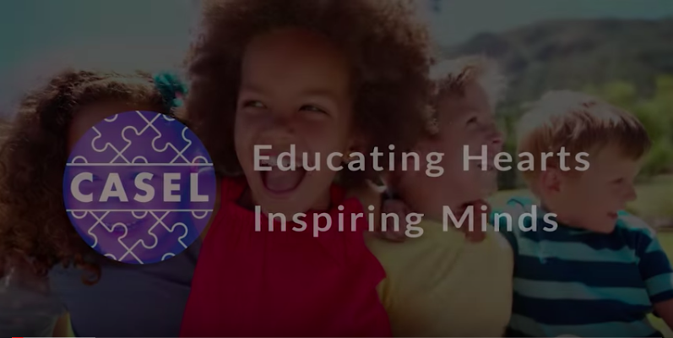
What’s possible with SEL?
Notes:
(15 min)
LINK: https://youtu.be/4YxyAcV9QXc
(1 min) Introduce the video as being from CASEL - a national organization that supports social and emotional learning for all of our children.
(6 min) Watch the video
(5 min) In trios discuss what connections you can make between your current work and the national SEL movement?
(3 min) Ask for a few comments to share with the group

Slide 6
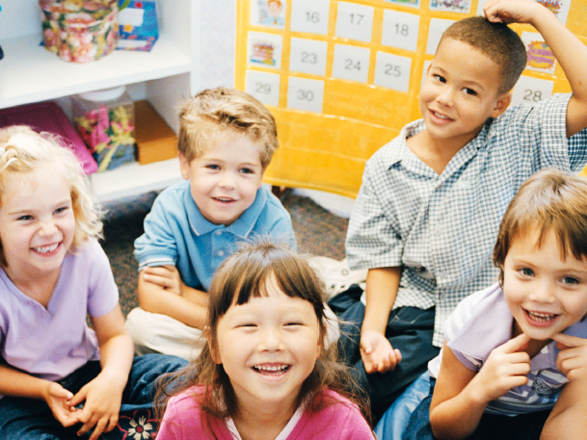
WHAT IS SOCIAL AND EMOTIONAL
LEARNING (SEL)?

Slide 7
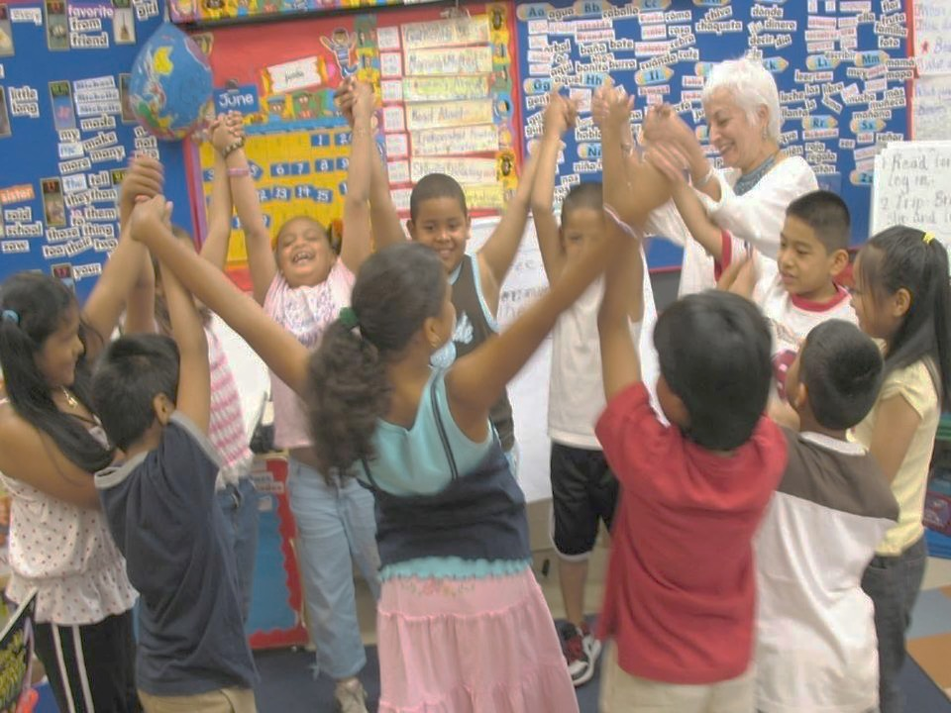
SEL is…
The process through which children and adults acquire and effectively apply the knowledge, attitudes, and skills necessary to understand and manage emotions, set and achieve positive goals, feel and show empathy for others, establish and maintain positive relationships, and make responsible decisions.
Notes:
Depending on the group select one of these options for engaging with the CASEL SEL definition:
Read aloud the definition. Pause. Ask participants to think and select a word or phrase that resonates with them today. Think silently why they selected that word/phrase. Turn and share in partners. At the end of 3 – 5 minutes ask for a few folks to share out (no more than 3). When one person shares out a word/phrase ask if any others selected the same one? This builds a sense of community and shared experience without having everyone share out loud.
If participants are familiar with SEL from previous work you might extend/exchange the prompt to ask them them what would they change in the definition? What would they add? Think and share why.

Slide 8
What are the SEL Competencies and skill sets?
Identifying emotions
Self-perception/Identity
Recognizing strengths
Sense of self-confidence
Self-efficacy
Impulse control
Stress management
Self-discipline
Self-motivation
Perseverance
Goal-setting
Organizational skills
SELF-
AWARENESS
SELF-
MANAGEMENT
Perspective-taking
Empathy
Appreciating diversity
Respect for others
Social and
Emotional
Learning
(SEL)
SOCIAL AWARENESS
RESPONSIBLE DECISION-
MAKING
RELATIONSHIP SKILLS
Identifying problems
Analyzing situations
Solving problems
Evaluating
Reflecting
Ethical responsibility
Communication
Social engagement
Building relationships
Working cooperatively
Resolving conflicts
Helping/Seeking help
Notes:
Let’s take a look a the Five Core SEL Competencies of Self-Awareness, Self-Management, Social Awareness, Relationship Skills, and Responsible Decision Making. These five competency clusters are interrelated and often operate simultaneously. Two of the clusters in red focus on intrapersonal skills related to the self, the two in blue focus on interpersonal skills related to others, and the one in green focuses on responsible decision making.
The Five SEL Core Competencies include skills that are significantly correlated to success in school, work, and life. [Read through them.]

Slide 9
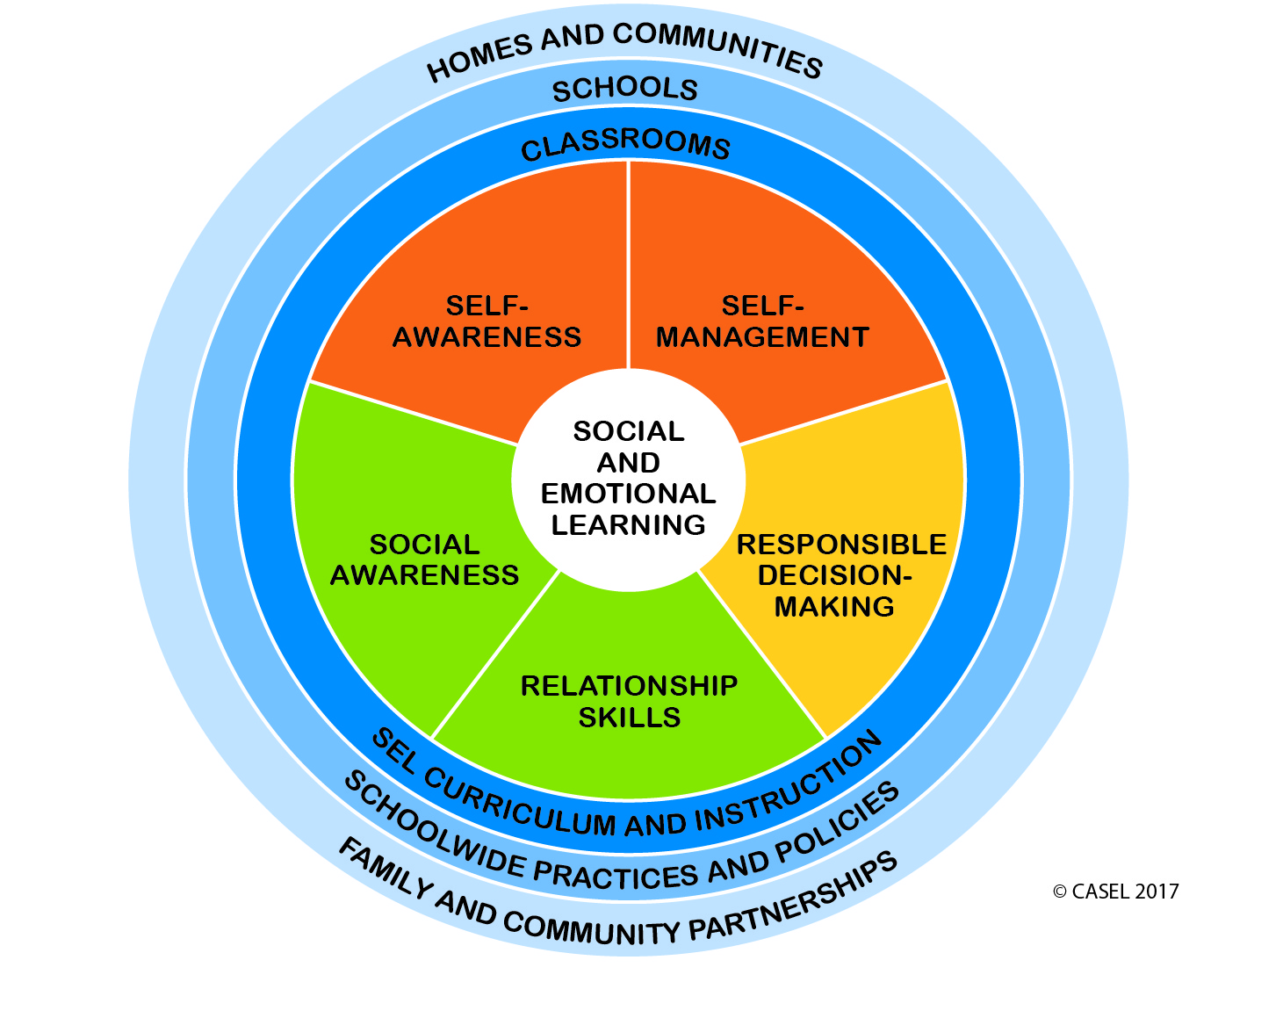
Schoolwide SEL
Notes:
SEL competencies are not developed in a vacuum – but through the experiences that students have in classrooms, throughout the school, and in their homes and communities.
Schoolwide SEL is a systemic approach to infusing social and emotional learning into every part of students’ educational experience -- across all classrooms, during all parts of the school day and out-of-school time, and in partnership with families and communities. This approach provides a learning environment that integrates SEL into all aspects of instruction and promotes equitable outcomes for all students.

Slide 10
Why SEL?

Slide 11
All learning is social.
All learning is emotional.
Notes:
Ask participants to read the statement on the screen and discuss what this means to them.
Possible discussion:
Students can’t learn when their social and emotional needs aren’t met.
Students learn not just through content delivery, but through the interactions they have with teachers and peers.
Students who have positive relationships with teachers are more likely to learn from them.
In order to learn, students need to have self-awareness, self-management, social awareness, relationship skills, and responsible decision-making skills

Slide 12
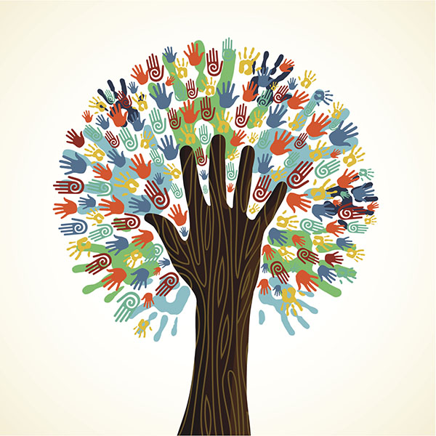
SEL as a Lever for Equity: SEL can help create caring, just, inclusive and healthy communities that support all students in reaching their fullest potential.
How can SEL help us create a more inclusive school and ensure all students have what they need to succeed?
Notes:
Systemic implementation of SEL both fosters and depends upon an equitable learning environment, where all students and adults feel respected, valued, and affirmed in their individual interests, talents, social identities, cultural values and backgrounds.
While SEL alone will not solve longstanding and deep-seated inequities in the education system, it can help schools promote understanding, examine biases, reflect on and address the impact of racism, build cross-cultural relationships, and cultivate adult and student practices that close opportunity gaps and create a more inclusive school community. In doing so, schools can promote high-quality educational opportunities and outcomes for all students, irrespective of race, socioeconomic status, gender, sexual orientation, and other differences.
As participants to discuss:
What is our school community already doing to ensure that every student gets what they need to succeed?
What are the ways that SEL can help create a more inclusive school and ensure all students have what they need to succeed?

Slide 13


SEL works:
Compelling national evidence
Science Links SEL to Student Gains:
Better social-emotional skills
Improved attitudes about self, others, and school
Positive classroom behavior
11 percentile-point gain on standardized achievement tests
Fewer conduct problems
Less emotional stress
Lower drug use
…and adults benefit too
Teachers who possess social and emotional competencies are more likely to stay in the classroom longer because they’re able to work more effectively with challenging students —one of the main causes of burnout.
Statistically significant associations between measured social-emotional skills in kindergarten and key young adult outcomes across multiple domains of education, employment, criminal activity, substance use, and mental health.
Notes:
13
13
In order to lead happy and productive lives, it’s critical that people understand themselves and master a variety of other crucial skills, attitudes, and mindsets. These include forming healthy relationships, collaborating effectively, managing stress and conflict, pursuing ethical solutions to problems, advocating for themselves and others, and empathizing with others. We know from research that these attitudes and skills can be explicitly taught, learned, and practiced.
Research tells us that students are more successful in school and daily life when they:
Know and can manage themselves.
Understand the perspectives of others and relate effectively with them.
Make sound choices about personal and social decisions (Weissberg et al., 2016).
If we want students to cultivate these skills, attitudes, and mindsets throughout their lives, then SEL must be part of every child’s education.
Citations are not included on the slide but below for reference:
Meta-analysis source (top section): Durlak, J.A., Weissberg, R.P., Dymnicki, A.B., Taylor, R.D., & Schellinger, K. (2011). The impact of enhancing students’ social and emotional learning: A meta-analysis of school-based universal interventions. Child Development: 82 (1), 405-432.
Teacher burnout (bottom left): Jennings, P.A. & Greenberg, M.T. (2009). The prosocial classroom: Teacher social and emotional competence in relation to student and classroom outcomes. American Educational Research Association.
Adult outcomes (bottom right): Jones, D.E., Greenberg, M., & Crowley, M. (2015) Early social-emotional functioning and public health: The relationship between kindergarten social competence and future wellness. American Journal of Public Health 105 (11), 2283-2290.

Slide 14
public
Most important factor in school quality: teach cooperation, respect, problem solving
PDK Poll, 2017
employers
growth in jobs that require mastery of SEL skills outpaced growth of all other jobs
National Bureau of Economic Research, 2015
Demand is at an all- time high in every sector
district personnel
strong consensus among school/district administrators: SEL skills are important & should be taught in schools to all students
Ready to Lead survey, 2017
principals
95% are committed to developing students’ social and emotional skills in their schools
Ready to Lead survey, 2017
teachers
93% of teachers want a greater focus on social and emotional learning
Missing Piece survey, 2013
parents
3 out of 5 give greater importance to their children being happy & not overly stressed, than doing well in school Learning Heroes Parent Survey, 2017
students
The majority of high school and recent grads agree that going to a school that focuses on developing SEL skills would help better prepare them for life after high school Respected Survey, 2018
Notes:
Overview slide showing growing demand.
Over the last few years, across the country momentum has increased because the research has confirmed our instincts about what is important, and we see all sectors, including parents, employers, principals, teachers, and the STUDENTS THEMSLEVES who are screaming: WE BELIEVE SEL IS CRITICAL.

Slide 15
How can schools promote SEL?

Slide 16
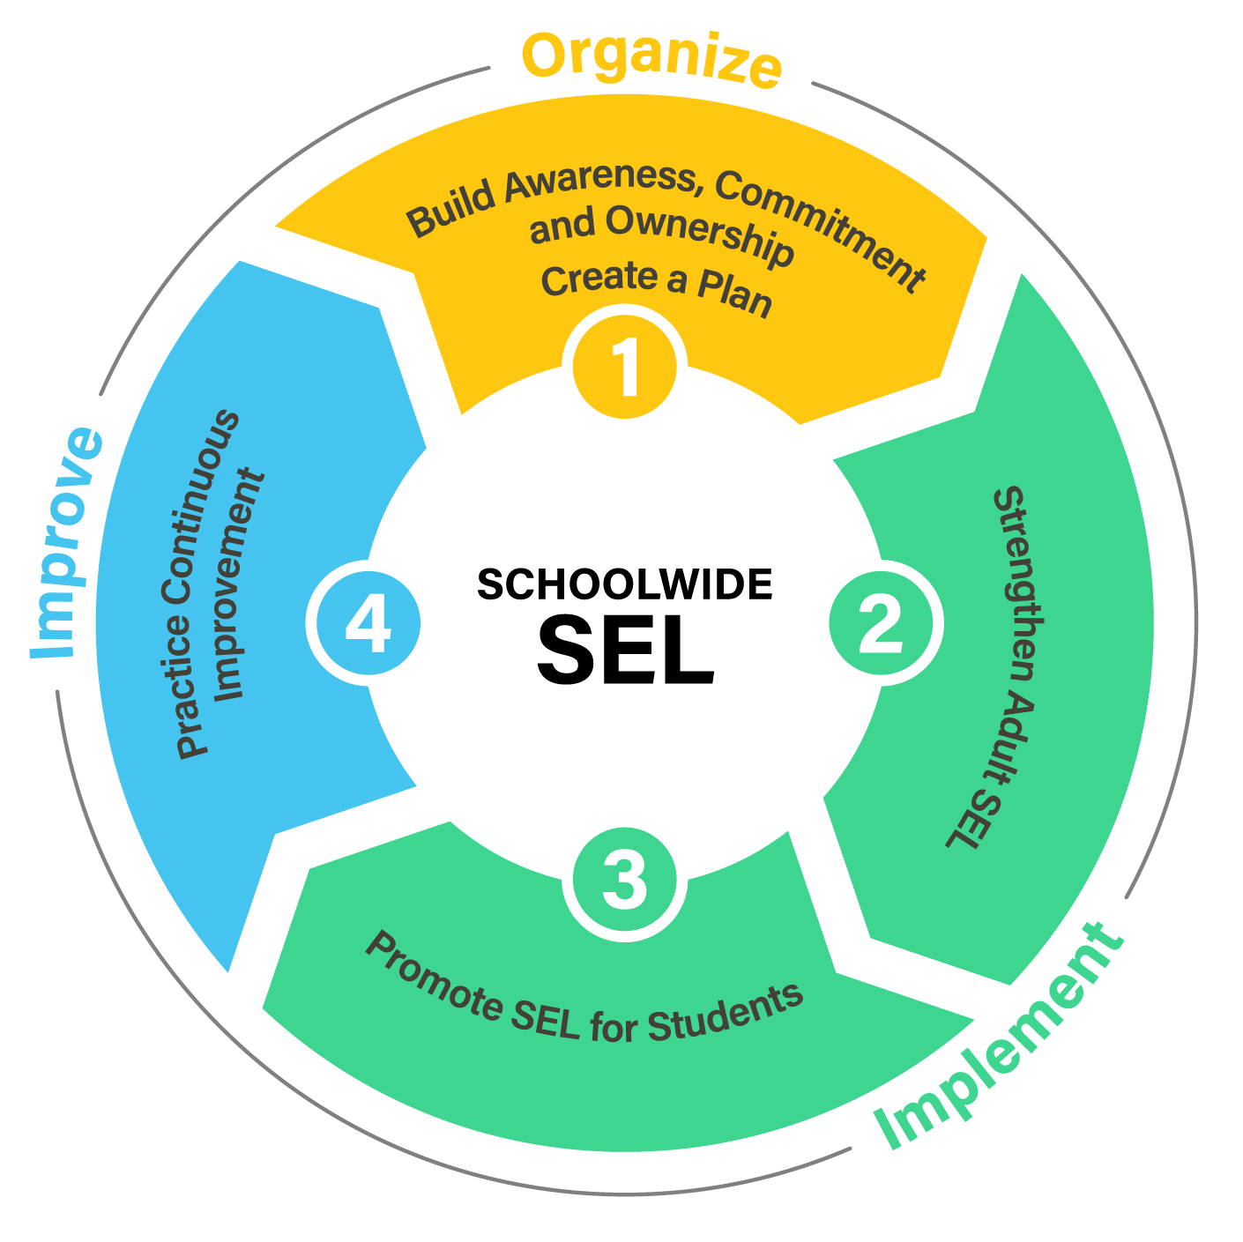
A Process for Schoolwide SEL
Notes:
Talking points:
Based on learnings from more than a decade of research and field-testing in districts across the country, CASEL has identified four focus areas of systemic implementation. This process for implementation is not linear or one-size-fits all, but the experience across dozens of school districts has demonstrated some common themes. First, it’s critically important that all schools begin with a strong foundation and plan for SEL. While students are the core of everything we do, what we’ve learned is that SEL implementation also depends upon adults who have strong social and emotional competencies and are skilled at promoting students’ SEL. Therefore, we find that successful schools often engage simultaneous in strategies that support both adult AND students’ SEL. The entire implementation process is driven by continuous improvement that helps schools quickly learn from what they’re doing and refine their efforts to ensure high-quality implementation that has lasting impact on students.
Participant reflection: Glancing at these areas of implementation, what work have we already been focused on? What areas have we paid less attention to? Why?
Transition: Let’s take a closer look at each focus area.

Slide 17
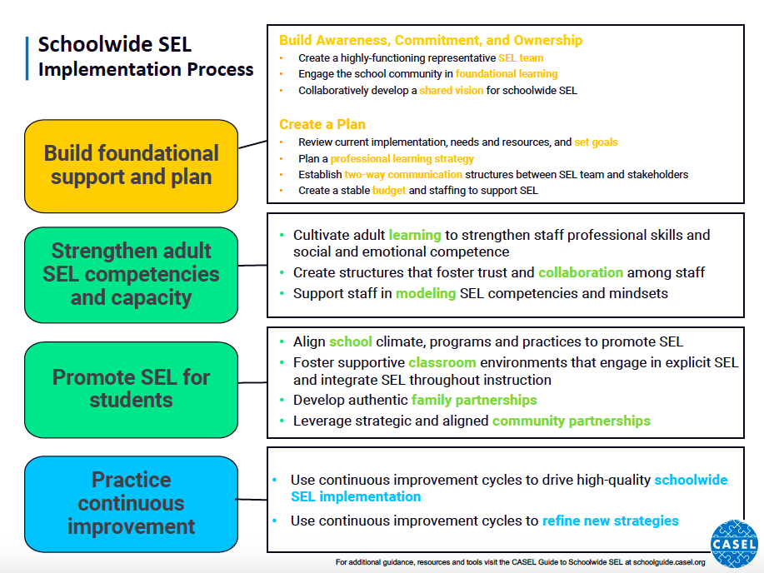

Slide 18
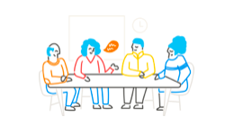
Focus Area 1
Build Foundational Support and Create a Plan
1A: Build Awareness, Commitment, and Ownership
•Create a highly-functioning representative SEL team
•Engage the school community in foundational learning
•Collaboratively develop a shared vision for schoolwide SEL
1B: Create a Plan
•Review current implementation, needs and resources, and set goals
•Plan a professional learning strategy
•Establish two-way communication structures between SEL team and stakeholders
•Create a stable budget and staffing to support SEL
Notes:
Talking points:
Focus Area 1 is a critically important starting point for schools to get organized. It has two parts focused on A) developing the foundational level of support needed to launch implementation, and B) creating a robust SEL plan.
This focus area helps schools set the stage for an intentional, collaborative effort to help SEL take root in the school. The steps that schools take help to create a common understanding of schoolwide SEL by establishing a team that is responsible for driving forward implementation. This process of building awareness commitment and ownership is cumulative. Awareness is only the first step – we want our schools to move beyond awareness and thinking “yes, SEL is a good idea” to commitment: “SEL is a good idea. Just tell me what to do and I’ll do it.” and move toward ownership – ”SEL is a good idea, it is my responsibility to do my part to cultivate SEL throughout my school. I know what to do and how to do it.”

Slide 19
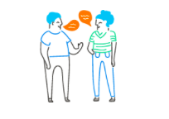
Focus Area 2
Strengthen Adult SEL Competencies and Capacity
Cultivate adult learning to strengthen staff professional skills and social and emotional competence
Create structures that foster trust and collaboration among staff
Support staff in modeling SEL competencies and mindsets
Notes:
Talking points:
Focus Areas 2 and 3 are all about promoting SEL for both staff and students, and the work in these focus areas is ongoing. You don’t need to “complete” Focus Area 2 before beginning Focus Area 3, and many schools engage in activities in both focus areas at the same time. The idea in Focus Area 2 is simply that schools continuously take stock of their needs surrounding adult SEL and establish systems and supports that strengthen both adult and student SEL.
Through CASEL’s Collaborating Districts Initiative (CDI), one of the key learnings was that schools are more effective at teaching and reinforcing SEL for students when they also cultivate adult SEL competencies and capacity. That’s because successful SEL implementation depends on how well staff work together to facilitate SEL instruction, foster a positive school community, and model social and emotional competence.
In this focus area, schools will work on strategies for supporting adults in developing both their professional skills as well as their social and emotional competence.
And just as promoting SEL for students isn’t just about skills development, promoting SEL for adults also means cultivating supportive and trusting relationships through intentionally structuring opportunities for collaboration to occur. Lastly, this focus area, guides adults in considering the importance of modeling SEL in their daily interactions throughout the school.
The goal is creating a work environment in which staff feel supported, empowered, able to collaborate effectively and build relational trust, and also able to develop their social and emotional skills -- so that they’re ready to promote SEL in students.
Turn & Talk: What is one way you’re already promoting adult SEL in your work?

Slide 20
Why Adult SEL?
Adults who have the ability to recognize, understand, label, express, and regulate emotions are more likely to demonstrate patience and empathy, encourage healthy communication, and create safe learning environments. (Brackett, Katella, Kremenitzer, Alster, and Caruso, 2008)
Teachers skilled at regulating their emotions report less burnout and more positive affect while teaching. (Brackett, Mojsa, Palomera, Reyes, & Salovey, 2008)
School leaders with strong SEL competencies build and maintain positive and trusting relationships among members of the school community. (Patti and Tobin, 2006)
Notes:
Read aloud these research quotes and ask participants to reflect on one that resonates with them at this moment. Turn and talk in trios to share their quote and why they selected it today.

Slide 21
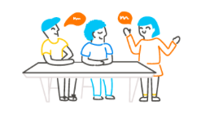
Focus Area 3
Promote SEL for Students
Align school climate, programs, and practices to promote SEL
Foster supportive classroom environments that engage in explicit SEL and integrate SEL throughout instruction
Develop authentic family partnerships
Leverage strategic and aligned community partnerships
Notes:
Talking points:
Focus Area 3 is really the heart of the schoolwide SEL process and what all of your efforts are aimed at - promoting SEL for students.
This involves much more than pulling out a few lessons to teach students about the five competencies.
Remember that definition for schoolwide SEL? If we want students to truly internalize SEL, they have to hear consistent messages, see it modeled, have opportunities to practice and reflect SEL throughout their daily lives. That means that promoting SEL must occur through systemic approach that integrates SEL schoolwide, in all classrooms, and in partnership with families and community.
Some key activities that schools engage in during this focus area include:
-Taking stock of their school climate and identifying efforts to improve climate, such as developing schoolwide norms
-Adopting an evidence-based program that provides structured opportunities for all students to practice SEL
-Fostering supportive classroom environments through community- and relationship-building
-Integrating SEL into academics, and explicitly teaching SEL
-Engaging families as partners in discussing and promoting SEL with strategies
-Aligning SEL efforts between in-school and out-of-school time

Slide 22
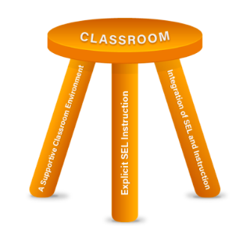
SEL in the Classroom: The Three-legged Stool
Notes:
When teachers take an equity approach, situating their instruction within a context of strong relationships and cultural knowledge consistently promoting marginalized voices and bringing elements of student choice into the lesson design they are practicing and modeling SEL. Teachers also engage in their own social and emotional learning while developing their own social-emotional and cultural competence.
There are three essential areas of implementation for establishing strong social-emotional and academic classrooms:
A supportive classroom environment
Explicit SEL instruction
Integration of SEL practices into daily instruction

Slide 23
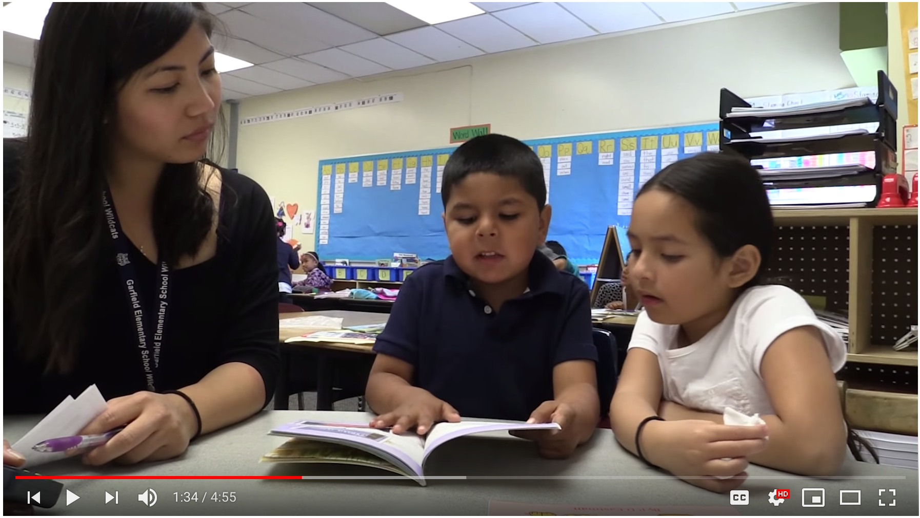
What does SEL look like?
Notes:
VIDEO LINK: Jaymie Sacramento, 1st grade teacher in Oakland, CA. https://www.youtube.com/watch?v=0QYECoGey9o&list=PLjTBw7Pj1x5yuL3YYPi6PKPG62nbi-ePR&index=2
Gather in trios to view video clip: One person focuses on ways the teacher has built a supportive classroom environment. One person looks for ways that SEL is integrated into academic learning. One person looks for evidence that the students have had explicit SEL instruction (their language and behavior showing self-awareness (identity, goals), social awareness (the group), relationships (1:1), and responsible decision making (regarding lesson and assignments).

Slide 24

Focus Area 4
Practice Continuous Improvement
Use continuous improvement cycles to drive high-quality schoolwide SEL implementation
Use continuous improvement cycles to refine new strategies
Notes:
Talking points:
Focus Area 4: Practice continuous improvement, comes last numerically but continuous improvement really drives the entire implementation process and is embedded throughout the other focus areas.
This focus area helps schools develop a system for continuous improvement so that they have structured processes for:
collecting schoolwide data for implementation and outcomes
reflecting on those data frequently in structured and consistent ways
using data for decision-making on a regular basis

Slide 25
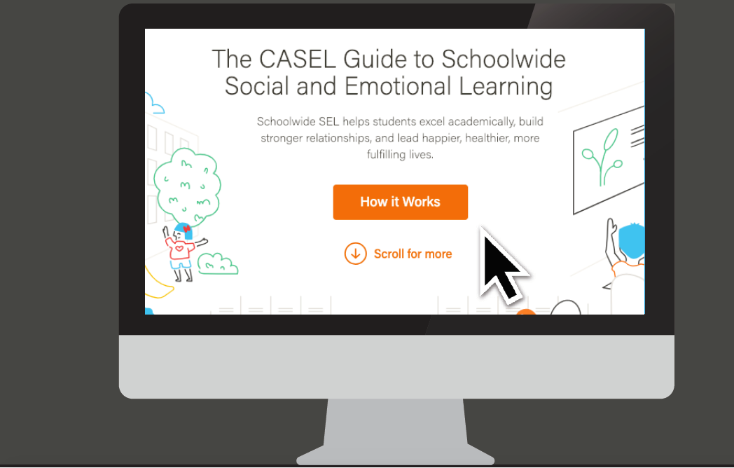
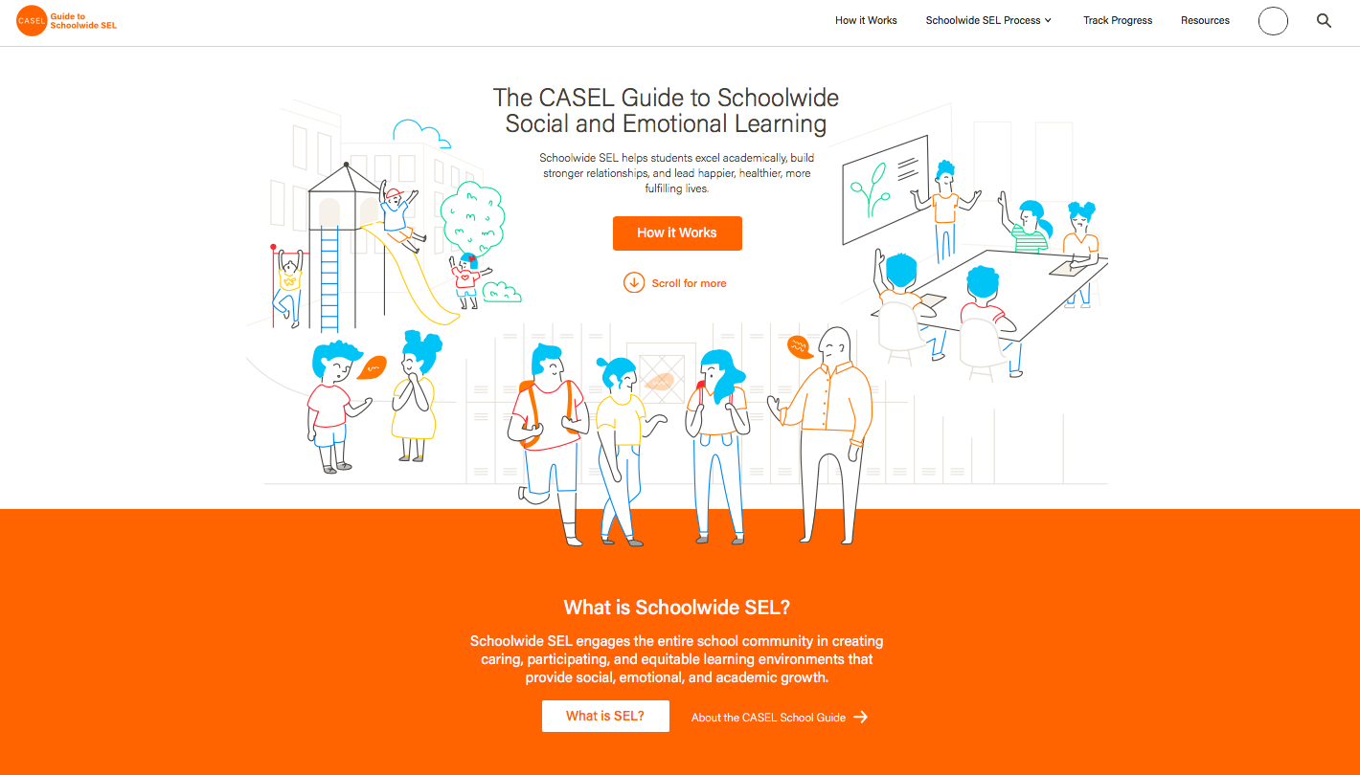
The CASEL Guide to Schoolwide
Social and Emotional Learning
schoolguide.casel.org
Notes:
Talking points:
You can go deeper into all of these focus areas and see the associated guidance, resources and downloadable tools at schoolguide.casel.org.
The school guide is continually being refined and improved, so please also share any feedback you have.
Presenter: You may want to open this up to a Q&A before closing out.
Suggested closing question:
What is one way you’re thinking differently about SEL?
What is one next step we should take together to promote SEL in our school?

Slide 26
How has your understanding of SEL changed?
Notes:
(5 min) This closing is an important part of learning and experiencing SEL so make sure you allow for enough time at the end. Take a few minutes for an Optimistic Closure that helps participants make sense of their new learning and leave the meeting feeling connected to one another. This can be as simple as Turn to Your Partner and asking “What is something you learned that you want to think more about and why?” or the prompt on the slide. Additional activities are available in the SEL 3 Signature Practices Playbook.
Suggested closing questions:
What is one way you’re thinking differently about SEL?
What is one next step we should take together to promote SEL in our school?

Slide 27
Thank You!

