Slide 1
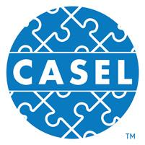
The Case for Social and Emotional Learning:
Powerpoint template*
* don’t forget to explore the notes
casel.org
Notes:
These slides are divided into 6 basic parts that are easy to customize and/or localize.
Slides 3-4: What is SEL
Slides 5-14:. the scientific evidence that documents SEL’s benefits.
Slides 15-23: CASEL framework – competence areas and key settings
Slides 24-26: CASEL’s theory of actions for effective implementation
Slides 26-34: surveys that document the growing demand for SEL from all sectors.
Slide 35: Resources that can help you

Slide 2
WHAT IS SEL…
casel.org

Slide 3
Social and emotional learning (SEL) is an integral part of education and human development. SEL is the process through which all young people and adults acquire and apply the knowledge, skills, and attitudes to develop healthy identities, manage emotions and achieve personal and collective goals, feel and show empathy for others, establish and maintain supportive relationships, and make responsible and caring decisions.
SEL advances educational equity and excellence through authentic school-family-community partnerships to establish learning environments and experiences that feature trusting and collaborative relationships, rigorous and meaningful curriculum and instruction, and ongoing evaluation. SEL can help address various forms of inequity and empower young people and adults to co-create thriving schools and contribute to safe, healthy, and just communities.
SEL is…
casel.org
Notes:
Updated CASEL’s definition and framework descriptions to reflect our continuous learning from SEL research, practice and policy
4 key points in updating SEL:
Explicit commitment to equity and excellence that emphasizes Identity, agency, belonging
Highlight spaces & places where SEL can be promoted
A need to infuse SEL into curriculum/instruction, OST, discipline, student support services, PL
Reflect the role of ongoing assessment for continuous improvement

Slide 4
BENEFITS
OF SEL…
casel.org
Notes:
Benefits of SEL
We know from a large body of research on SEL that high-quality SEL programming leads to improved academic performance, decreases in anxiety and behavior issues, among other benefits.
We also know from research beyond the traditional SEL field that there are additional insights to be gained that are relevant to SEL.

Slide 5
Notes:
An overview slide for those who want only one slide, with research highlights. It combines findings from several studies on one slide. Note that the citations are not on the actual slide, but they are here in case you are asked:
Benefits of SEL
•We know from a large body of research on SEL that high-quality SEL programming leads to improved academic performance, decreases in anxiety and behavior issues, among other benefits.
•We also know from research beyond the traditional SEL field that there are additional insights to be gained that are relevant to SEL.
Meta-analysis source (first 3) Durlak, J.A., Weissberg, R.P., Dymnicki, A.B., Taylor, R.D., & Schellinger, K. (2011). The impact of enhancing students’ social and emotional learning: A meta-analysis of school-based universal interventions. Child Development: 82 (1), 405-432.
Financial investment (bottom): Belfield, C., Bowden, B., Klapp, A., Levin, H., Shand, R., & Zander, S. (2015). The Economic Value of Social and Emotional Learning. New York: Center for Benefit-Cost Studies in Education.

Slide 6
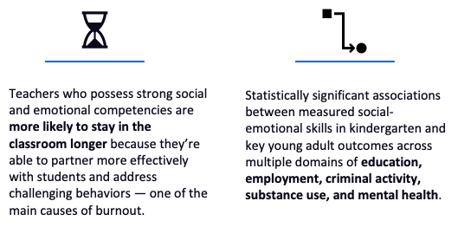
Notes:
Benefits of SEL for adults
Teacher burnout (bottom left): Jennings, P.A. & Greenberg, M.T. (2009). The prosocial classroom: Teacher social and emotional competence in relation to student and classroom outcomes. American Educational Research Association.
Adult outcomes (bottom right): Jones, D.E., Greenberg, M., & Crowley, M. (2015) Early social-emotional functioning and public health: The relationship between kindergarten social competence and future wellness. American Journal of Public Health 105 (11), 2283-2290.

Slide 7
Science Links SEL to Student Gains: Landmark study documented multiple benefits of SEL
Science Links SEL to Student Gains:
Social-emotional skills
Improved attitudes about self, others, and school
Positive classroom behavior
11 percentile-point gain on standardized achievement tests
Reduced Risks for Failure:
Conduct problems
Emotional distress
2011 meta-analysis of 213 studies involving school-based, universal SEL programs including over 270,000 students in K-12 revealed:
Source: Durlak, J.A., Weissberg, R.P., Dymnicki, A.B., Taylor, R.D., & Schellinger, K. (2011) The impact of enhancing students’ social and emotional learning: A meta-analysis of school-based universal interventions. Child Development: 82 (1), 405-432.
Notes:
7
7
This is a great slide on the most cited and compelling research on SEL, the 2011 meta-analysis. Findings from this are incorporated into the previous slide, but if you have time to spend on just this, it’s a great slide.
Specifically, you can talk about each of the bullets as their own compelling piece of evidence. Depending on your audience, you may want to emphasize certain points. For example:
Not only did we learn from this meta-analysis that SEL programming leads to improvements in SEL skills, we also see some other important outcomes:
Improved attitudes about self, others, and school (extremely important and cited by educators as one of the main reasons they value SEL, so it’s good to emphasize this if audience is school-based folks).
Positive classroom behavior (this is important, but be careful not to over emphasize this point for fear that people think SEL is primarily a behavior-management solution, which is a common misperception).
11 percentile point gain on academics: This is a significant data point that warrants emphasis. This kind of improvement on academics is frankly what has gotten the attention of so many. This data point can foster the transition from a belief that these are “soft skills,” nice-to-haves, to the idea that these are critically important and to be taken seriously.
And don’t forget about the data points in red:
Reductions in conduct problems is an important finding, but once again, it’s important to be wary of folks who think of SEL as behavior management and are looking to “fix broken kids.” See note above.
Reductions in emotional distress warrants significant emphasis. We’re living in a time when emotional distress, depression, anxiety, and suicide are at an all-time high. Understanding that SEL can have an impact here is important, but with a word of caution: SEL should not be viewed as a solution for mental illness.

Slide 8
Impact of SEL:
long-lasting and global
A 2017 research study finds that SEL programs benefit children for months and even years.
82
97,000+
Students, kindergarten through middle school
6 mo – 18 yrs
after programs completed
different programs reviewed (38 outside U.S.)
SEL Students Benefit in Many Areas
Academic performance
SEL skills
Positive attitudes
Positive social behaviors
Conduct problems
Emotional distress
Drug use
Higher social and emotional competencies among SEL students at the end of the initial intervention was the best predictor of long-term benefits.
Benefits were the same regardless of socioeconomic background, students’ race, or school location.
Source: Child Development (July 2017). “Promoting Positive Youth Development Through School-Based Social and Emotional Learning Interventions: A Meta-Analysis of Follow-Up Effects”
Notes:
This slide shows the longitudinal impact of SEL programming. This 2017 meta-analysis included the 82 studies that showed longitudinal affects, and the results show that the gains are LASTING. SEL programming isn’t just a shot in the arm that benefits in the short term. There are long lasting benefits that go beyond school outcomes.
And don’t forget to point out this note at the bottom of the slide:
“Higher social and emotional competencies among SEL students at the end of the initial intervention was the best predictor of long-term benefits. Benefits were the same regardless of socioeconomic background, students’ race, or school location. “

Slide 9
SEL benefits adults, too Positive impact on teachers
Teachers with high levels of social competence are better able to protect themselves from burnout by:
Developing and managing nurturing relationships with their students
Serving as behavioral role models for children
Regulating their own emotions
Teachers who possess social and emotional competencies are more likely to stay in the classroom longer.
Source: Jennings, P.A. & Greenberg, M.T. (2009) The Prosocial Classroom: Teacher Social and Emotional Competence in Relation to Student and Classroom Outcomes. American Educational Research Association.
Notes:
This point is also on the summary (slide 2). You may want to emphasize this to highlight the importance of SEL on teacher retention. Needless to say, this is a good one for teachers and principals to see!

Slide 10
Benefits of SEL: Linked to young adult outcomes
Statistically significant associations exist between measured social-emotional skills in kindergarten and young adult outcomes across multiple domains:
Kindergartners who were stronger in SEL competence were more likely to:
graduate from high school
complete a college degree
obtain stable employment in young adulthood
And less likely to be:
x living in public housing
x receiving public assistance
x involved with police
x in a detention facility
Source: Damon E. Jones, Mark Greenberg, and Max Crowley. Early Social-Emotional Functioning and Public Health: The Relationship Between Kindergarten Social Competence and Future Wellness. American Journal of Public Health: November 2015, Vol. 105, No. 11, pp. 2283-2290.
Notes:
This is a great slide to show the power of SEL on predicting future outcomes in school and in life.
Important notes to add include:
This study controlled for demographics (socioeconomic status, race/ethnicity, etc.).
Also may want to add the fact that while the kindergartener’s high or low SEL predicted their adult outcomes, you are not doomed if you don’t have strong SEL in kindergarten! We know from research that SEL is teachable! We can improve SEL and therefore these outcomes if we are intentional and evidence-based in our approach to the work!
This is also a good slide for more politically conservative audiences who like the idea of educational programming that reduces the likelihood of dependency on social programs and public assistance.

Slide 11
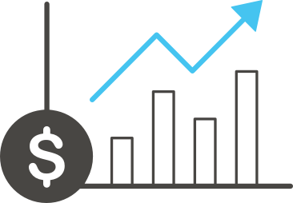
Benefits of SEL: Strong return on investment
Wise financial investment according to cost-benefit research. The average return on investment for six evidence-based programs is:
11 to 1
meaning for every dollar invested there is an $11 return, savings from costs not incurred for intervention
Source: Belfield, C., Bowden, B., Klapp, A., Levin, H., Shand, R., & Zander, S. (2015). The Economic Value of Social and Emotional Learning. New York: Center for Benefit-Cost Studies in Education.
Notes:
This is a really important slide for school boards, funders, and anyone who prioritizes or questions the cost benefit analysis of SEL programming. This study out of Columbia University shows that for every dollar invested in SEL programming, you save $11 dollars that would have been spent on costly interventions, remediation, dropout prevention, recovery, etc.

Slide 12
Benefits of SEL: Compelling local evidence
[School/district name] has seen improvements in:
Data point 1
Data point 2
Data point 3
… and declines in:
Data point 1
Data point 2
Data point 3

Slide 13
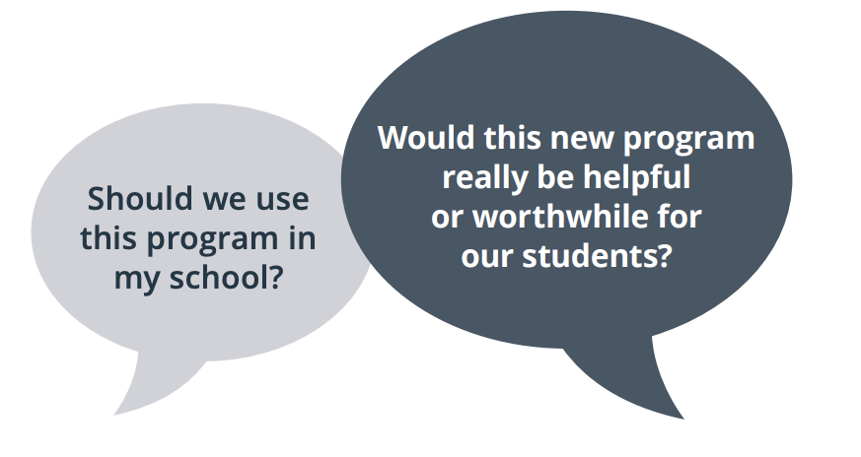
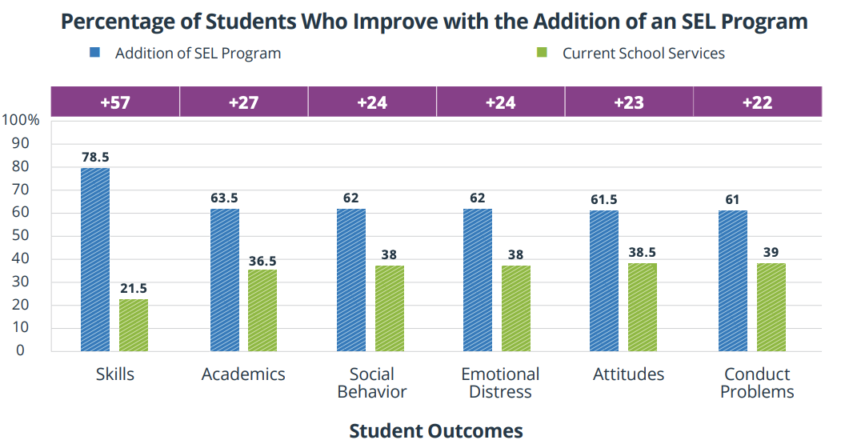
Practical Benefits of an SEL Program: Based on the 2011 meta-analysis
Adding an SEL program is likely to be a wise choice compared to students receiving current school services.
For example:
27% more students would improve their academic performance at the end of the program
57% more would gain in their skills levels
24% more would have improved social behaviors and lower levels of distress
23% more would have improved attitudes
22% more would show fewer conduct problems
Notes:
13
13
Even gains of 22% in terms of fewer conduct problems is a worthwhile benefit because it reflects what an SEL program can add to school services compared to what each school is currently doing. In sum, current data collected from many studies indicates that adding a SEL program to the school curriculum can lead to several real-life benefits for students.
Source: https://casel.org/wp-content/uploads/2019/12/Practical-Benefits-of-SEL-Program.pdf

Slide 14
CASEL’s SEL
Framework:
What are the Core Competence Areas and Where are they Promoted?
casel.org
Notes:
CASEL’s SEL framework fosters knowledge, skills, and attitudes across five areas of competence and multiple key settings to establish equitable learning environments that advance students’ learning and development.
In a commitment to highlight the potential and urgency of leveraging SEL to promote educational equity and excellence, we updated our framework and definitions in October 2020.
This reflects insights from a 2019 research article, Transformative SEL: Toward SEL in Service of Educational Equity and Excellence, and from our research-practice partnerships to advance ways that SEL supports equitable learning environments and optimal developmental outcomes for diverse children, adolescents, and adults.

Slide 15
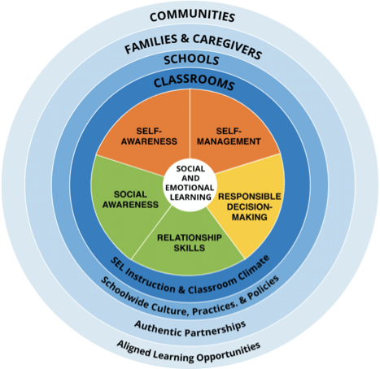
The
CASEL 5...
Five broad and interrelated areas of competence:
Self-awareness
Self-management
Social awareness
Relationship skills
Responsible decision-making
@caselorg | #WhatisSEL
Notes:
The CASEL 5 can be taught and applied at various developmental stages from childhood to adulthood and across diverse cultural contexts. Many school districts, states, and countries have used the CASEL 5 to establish preschool to high school learning standards and competencies that articulate what students should know and be able to do for academic success, school and civic engagement, health and wellness, and fulfilling careers.
Updated descriptions of competencies and added additional bulleted examples to reflect the growing research and more inclusive understanding of competence development and SEL as a lever for equity and excellence
Includes attention to children, adolescents, and adults
Note that bullets are examples not exhaustive

Slide 16
SELF-AWARENESS
The abilities to understand one’s own emotions, thoughts, and values and how they influence behavior across contexts. This includes capacities to recognize one’s strengths and limitations with a well-grounded sense of confidence and purpose.
Such as:
Integrating personal and social identities
Identifying personal, cultural, and linguistic assets
Identifying one’s emotions
Demonstrating honesty and integrity
Linking feelings, values, and thoughts
Examining prejudices and biases
Experiencing self-efficacy
Having a growth mindset
Developing interests and a sense of purpose
@caselorg | #WhatisSEL
Notes:
Self Awareness: which includes, for example, how we understand our cultural and linguistic assets, as well as our prejudices and biases

Slide 17
SELF-MANAGEMENT
The abilities to manage one’s emotions, thoughts, and behaviors effectively in different situations and to achieve goals and aspirations. This includes the capacities to delay gratification, manage stress, and feel motivation and agency to accomplish personal and collective goals.
Such as:
Managing one’s emotions
Identifying and using stress-management strategies
Exhibiting self-discipline and self-motivation
Setting personal and collective goals
Using planning and organizational skills
Showing the courage to take initiative
Demonstrating personal and collective agency
@caselorg | #WhatisSEL
@caselorg | #WhatisSEL
Notes:
Self Management: which includes how we set both personal and collective goals and take collective action to effect change

Slide 18
SOCIAL AWARENESS
The abilities to understand the perspectives of and empathize with others, including those from diverse backgrounds, cultures, and contexts. This includes the capacities to feel compassion for others, understand broader historical and social norms for behavior in different settings, and recognize family, school, and community resources and supports.
Such as:
Taking others’ perspectives
Recognizing strengths in others
Demonstrating empathy and compassion
Showing concern for the feelings of others
Understanding and expressing gratitude
Identifying diverse social norms, including unjust ones
Recognizing situational demands and opportunities
Understanding the influences of organizations and systems on behavior
@caselorg | #WhatisSEL
@caselorg | #WhatisSEL
Notes:
Social Awareness: which includes how we understand diverse social norms, including unjust ones, and understand the systemic influences on our behaviors

Slide 19
RELATIONSHIP SKILLS
The abilities to establish and maintain healthy and supportive relationships and to effectively navigate settings with diverse individuals and groups. This includes the capacities to communicate clearly, listen actively, cooperate, work collaboratively to problem solve and negotiate conflict constructively, navigate settings with differing social and cultural demands and opportunities, provide leadership, and seek or offer help when needed.
Such as:
Communicating effectively
Developing positive relationships
Demonstrating cultural competency
Practicing teamwork and collaborative problem-solving
Resolving conflicts constructively
Resisting negative social pressure
Showing leadership in groups
Seeking or offering support and help when needed
Standing up for the rights of others
@caselorg | #WhatisSEL
@caselorg | #WhatisSEL
Notes:
Relationship skills: which includes how we demonstrate cultural competency and stand up for the rights of others
Collaborating
Good relationships
Managing conflict
Showing leadership
seeking/offering help
Standing up for rights of others

Slide 20
RESPONSIBLE DECISION-MAKING
The abilities to make caring and constructive choices about personal behavior and social interactions across diverse situations. This includes the capacities to consider ethical standards and safety concerns, and to evaluate the benefits and consequences of various actions for personal, social, and collective well-being.
Such as:
Demonstrating curiosity and open-mindedness
Learning how to make a reasoned judgment after analyzing information, data, and facts
Identifying solutions for personal and social problems
Anticipating and evaluating the consequences of one’s actions
Recognizing how critical thinking skills are useful both inside and outside of school
Reflecting on one’s role to promote personal, family, and community well-being
Evaluating personal, interpersonal, community, and institutional impacts
@caselorg | #WhatisSEL
@caselorg | #WhatisSEL
Notes:
Responsible decision-making: which includes how we work toward solutions to personal or social problems, and how we support collective well-being

Slide 21
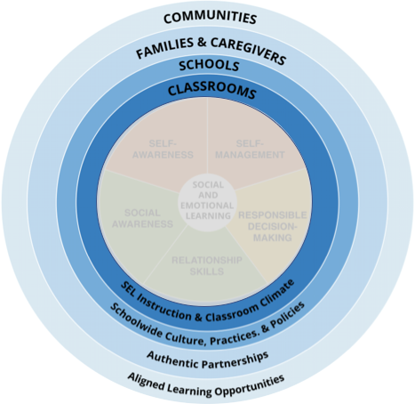
The Key Settings...
Our framework takes a systemic approach that emphasizes the
importance of establishing equitable learning environments and coordinating practices across key settings of classrooms, schools, families, and communities to enhance all students’ social, emotional, and academic learning.
@caselorg | #WhatisSEL
Notes:
Rings/settings
These competencies are not developed inside a vacuum but our learning and development is shaped by our interactions, relationships, and environments.
This is why CASEL’s framework also emphasizes the role of settings and authentic school-family-community partnerships that coordinate practices across learning environments.
While the core competencies have received more focus, we really want to make sure people are using the whole framework and are trying to elevate the importance of these rings, which represent the settings where students live and learn.
First, it’s important to understand that these settings are part of broader context of systems with inherent inequities based on race and other factors. SEL offers a way for adults and students to acknowledge and respond to these inequities.

Slide 22
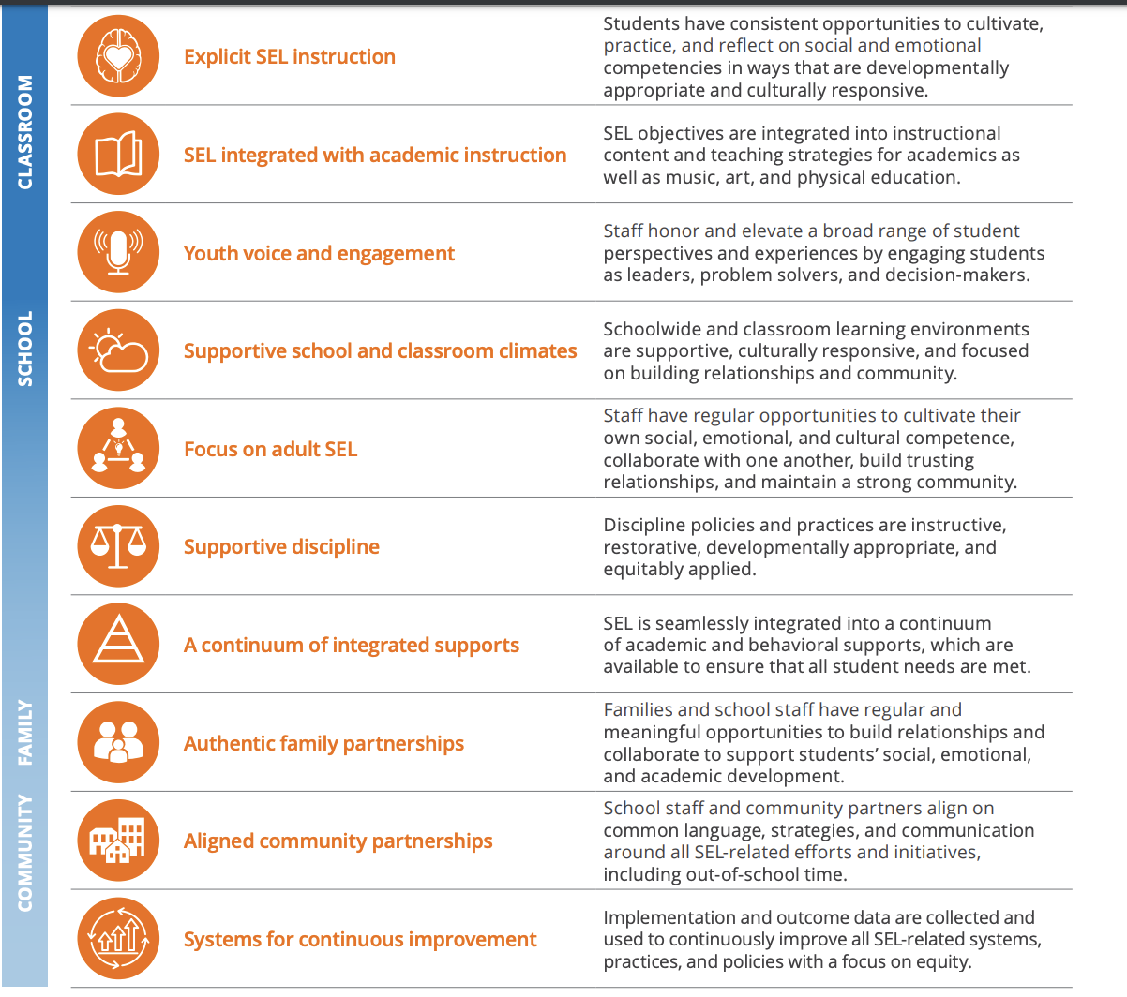
Indicators of Schoolwide SEL...
Notes:
10 indicators - what would you actually see in a school that’s prioritizing SEL
These ten indicators of schoolwide SEL provide schools with evidence of high-quality implementation of the School Guide’s four focus areas. They are not a “checklist” or a “to-do” list, and attempting to address one or a few of these items in isolation without engaging in systemic implementation could lead to fragmented, siloed SEL.

Slide 23
CASEL’s Theory of Action
for Effective Implementation
casel.org
Notes:
For SEL to be most effective, it is essential that states, regions, districts, and schools infuse the principles of SEL across curriculum and instruction, discipline, out-of-school time, and ongoing assessment for continuous improvement.

Slide 24
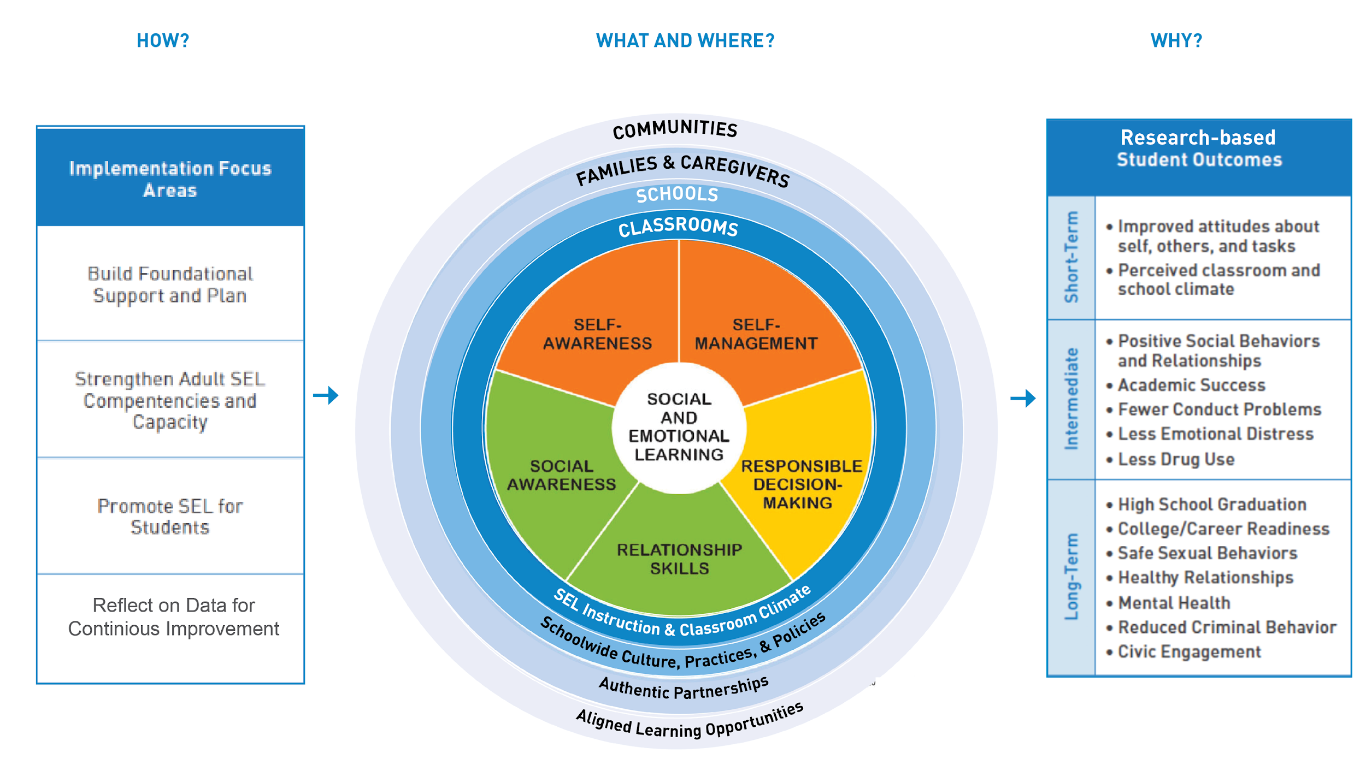
Our Theory of Action for Effective Implementation
Our SEL Framework is guided by a Theory of Action across the school, district, and state to comprehensively
support quality SEL implementation.
It reflects years of field testing.
Notes:
As demand for SEL has grown, importance of understanding the “how”
We’ve learned from CDI, CSI about the conditions that need to exist to support quality SEL implementation that’s informed our TOA
Outline four focus areas briefly,
Build foundational support and plan by establishing a collective vision and plan for SEL, and ensuring aligned resources and ongoing commitment.
Strengthen adult SEL competencies and capacity by cultivating a trusting community that enhances adults’ professional, social, emotional, and cultural competencies and their capacity to promote SEL for students.
Promote SEL for students by developing a coordinated approach across classrooms, schools, homes, and communities that ensures consistent, culturally responsive, and developmentally appropriate opportunities for all students to enhance and apply social and emotional competencies to daily tasks and challenges.
Reflect on data for continuous improvement by establishing an ongoing process to collect and use implementation and outcome data to inform decisions and drive improvements

Slide 25
GROWING DEMAND FOR SEL
casel.org
Notes:
Over the last few years, across the country momentum has increased because the research has confirmed our instincts about what is important, and we see all sectors, including parents, employers, principals, teachers, and the STUDENTS THEMSLEVES who are screaming: WE BELIEVE SEL IS CRITICAL.

Slide 26
Employers value SEL
Of surveyed executives say skills such as problem-solving and communicating clearly are equally or more important than technical skills.
National Bureau of Economic Research, 2015
The Top 10 skills identified by the World Economic Forum all involve social and emotional competence.
And research shows that social and emotional skills and attitudes also contribute to the other skills such as critical thinking.
Source: Future of Jobs Report, World Economic Forum
Complex problem solving
Critical thinking
Creativity
People management
Coordinating with others
Emotional intelligence
Judgment and decision-making
Service orientation
Negotiation
Cognitive flexibility
Notes:
This slide can be useful for those wanting to know what employers think.

Slide 27
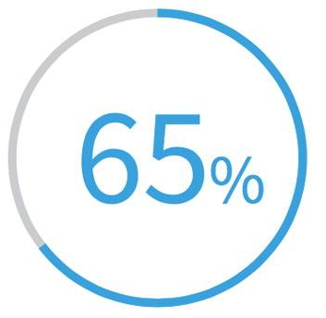
Employers value SEL
Of surveyed executives say they’d rather colleges build up students’ life skills.
High Point University survey, 2018
7 top characteristics of success at the company are all SEL-related skills, such as communicating and listening well; possessing insights into others; and having empathy.
Priorities: Conflict resolution, leadership, and civic engagement
Wanted: Employees Who Can Shake Hands, Make Small Talk
Bank of America teaches empathy in-house; Subaru pays for soft-skills training (Dec. 10, 2018)
Notes:
For those wanting to know what employers think—part 2

Slide 28
Administrators, Parents, and Teachers value SEL
The overwhelming majority of administrators (96%), teachers (93%) and parents (81%) believe that social and emotional learning is just as important as academic learning.
Teaching SEL skills in the classroom is most important for improving:
Negative student behaviors such
as bullying
– according to teachers
and administrators
School safety
– according to parents
Source: 2018 Social and Emotional Learning report, 2018
Notes:
More recently, a new report from McGraw Hill was released in 2018 sharing findings from a survey conducted by Morning Consult from September 6-11, 2018.T he findings represent a national sample of 1,140 teachers, administrators and parents.
Overall, administrators, teachers and parents agree: SEL is crucial.

Slide 29
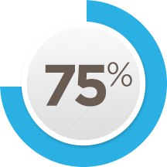
Principals value SEL
Social and emotional skills are teachable in a school setting.
I am very/fairly committed to developing students’ social and emotional skills in my school.
Definitely teachable 74%
Probably teachable 25%
99%
Very committed 69%
Fairly committed 26%
95%
believe students from all types of background would benefit from SEL
Source: Ready to Lead, 2017
Notes:
For those wanting to know what principals think

Slide 30
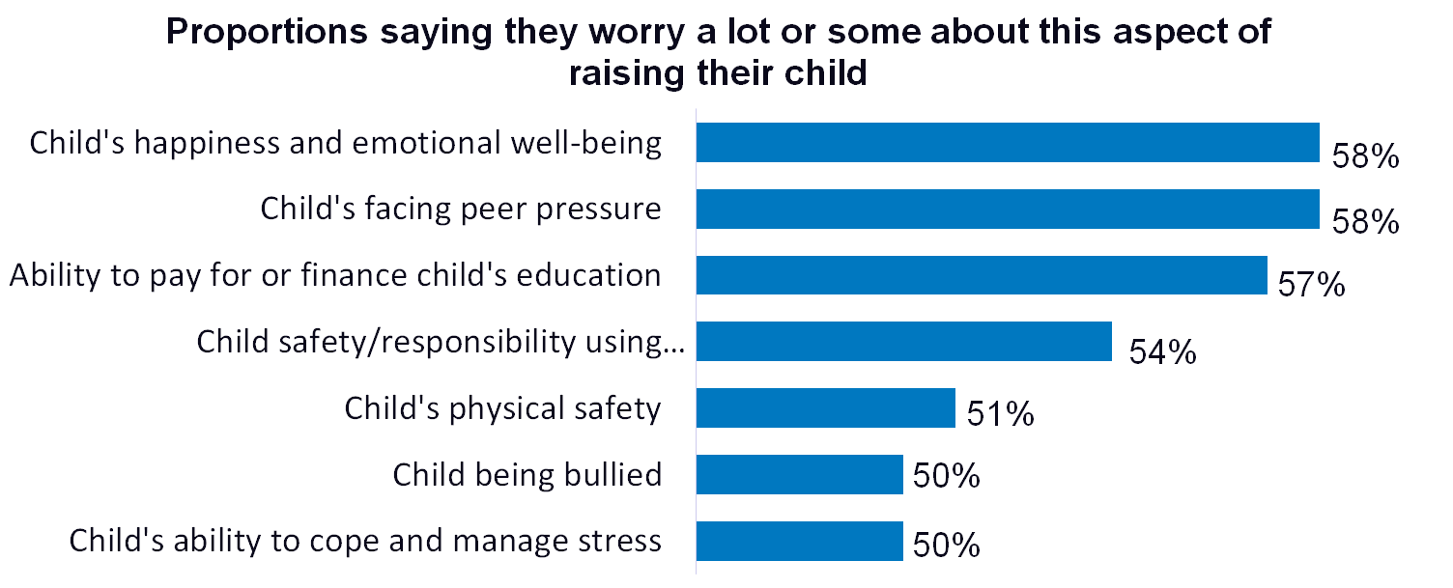
Parents value SEL
say “being happy/not overly stressed”
is more important than academics.
3 out 5 parents
*The research says this is a false choice: social and emotional well-being contributes to academic success, among other benefits.
Source: Learning Heroes, 2017
Notes:
For those wanting to know what parents think

Slide 31
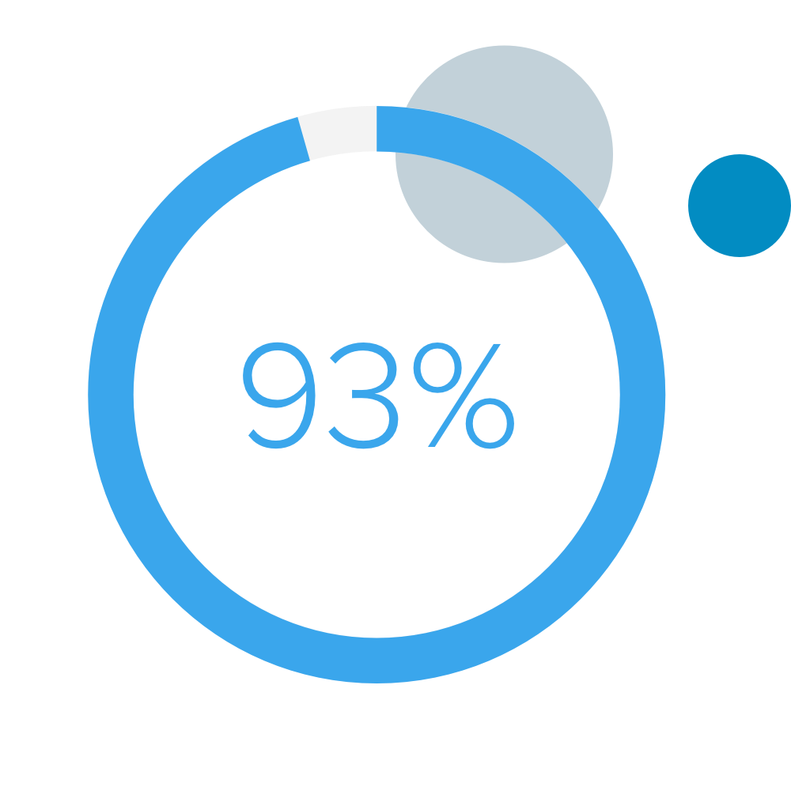
Teachers value SEL
In 2013, we learned that:
Teachers cite positive effects on:
want a greater focus on SEL in schools
Workforce readiness
Life success
Attendance/graduation
College preparation
Academic success
87%
87%
80%
78%
75%
More recently:
Report that they are devoting more time to teaching SEL skills today compared to five years ago.
74%
Source: 2018 Social and Emotional Learning report, 2018
Source: The Missing Piece, 2013
Notes:
For those wanting to know what teachers think

Slide 32
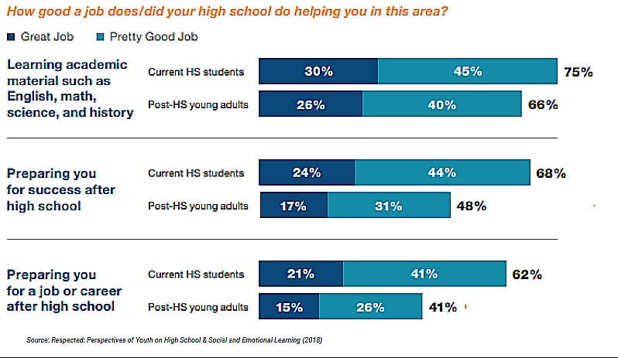
Students value SEL
Recent high school graduates see significant deficits in high schools preparing for life after school.
Source: Respected: Perspectives of Youth on High School & Social and Emotional Learning (2018)
Notes:
In terms of how well their high school prepares students for success after high school: 68 percent of current high school students believe their school is doing a good job of preparing them for success after high school; less than half of former high school students (48 percent) agree.
In terms of how well their high school does at preparing students for a job or career: More than half (62 percent) of current high school students think their high school is doing a good job preparing them for a job or career. Once again, most young adults out of high school disagree.

Slide 33
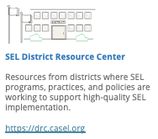
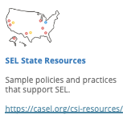
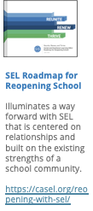
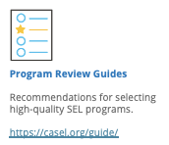
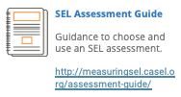
Notes:
https://casel.org/resources-support/

