Slide 1
Code of Character, Conduct, and Support
LINK: download key resource and examples here
Notes:
These slides accompany the free downloadable resource available at https://leadingschoolwidesel.casel.org/products/digital_downloads/code-of-conduct

Slide 2
The Problem
Notes:
The national conversation on the overuse and disproportionate use of exclusionary punishments is ongoing for many districts and schools.
Many districts and schools use discipline practices that have a disparate impact on subgroups of students.

Slide 3
The National Conversation
For some groups of students,
exclusionary punishments result in…
1
2
3
4
5
Students entering the juvenile
justice system
Higher dropout rates
Greater loss of instructional time
Skipping school and lower attendance rates
Unsupervised time during school hours that puts students at higher risk
Notes:
Subgroups of children and adolescents are significantly impacted by exclusionary punishments, which result in higher dropout rates, loss of instructional time, attendance issues, students being at-risk in their communities, and students entering the juvenile justice system.
Nationally, students of color are roughly 2.5 times more likely to receive exclusionary punishment according to recent DOE data. Special education students are another subgroup that typically receive higher rates of exclusionary punishment than their peers.
Educators hold a collective responsibility to disrupt disproportional discipline practices to ensure that each and every student has access to a quality education.

Slide 4
Biases
Learning Biases
Racial Bias
Gender Bias
Developmental Biases
Cultural Bias
Conflict Aversion Biases
Negativity Bias
Notes:
One significant variable that deeply plays into discretionary discipline practices are the biases we bring to our responses with students.
Racial bias, a socially constructed bias, is where we sort racial groups and think that some racial groups are less worthy of our care and attention.

Slide 5
A Moral Mission
Equitable Student Outcomes
CODE
Notes:
Revising a Code of Character, Conduct, and Support is morally urgent work and courageous work.

Slide 6
The Gears
Notes:
Data on disproportionality points to a systemic problem, and systemic problems require systemic solutions.
These gears are interdependent and require shifts in mindsets and practices to address inequities.

Slide 7
The Opportunity:
A Visionary Code
Notes:
A key lever to address disproportional disciplinary practices is to implement a systemic approach to restorative and equitable discipline by rethinking/revising a district’s Code of Character, Conduct, and Support.

Slide 8
Code Impact Goals
Code Impact Goals
Goal 1: Decrease Use of Disciplinary Responses Resulting in Lost Instructional Time
Goal 2: Decrease Disproportional Application of Disciplinary Responses
Goal 3: Decrease Rates of Repeat Behavior Violations
Goal 4: Increase Academic Achievement for All Students
Goal 5: Increase Positive Perceptions and Mindsets for Students, Parents/Caregivers, and Staff
Notes:
A Code of Character, Conduct, and Support has the potential to be the north star for equitable practices in a district.
Clarity on the goals is essential to shifting practice among school and district staff, which in turn shifts outcomes for students.
These five impact goals inspire change, support accountability, and ensure that each and every student is supported, valued, and care for.
Progress towards these goals is measured through a dashboard that is created as part of the Code development process.

Slide 9
Universal Pre-K-12 Strategies for Promotion and Prevention
Notes:
Promotion and prevention strategies in the classroom are foundational for students.

Slide 10
Notes:
Often people think of the Code as solely a guide to discipline practices.
An effective Code is about creating districtwide and school communities that are just, engaging, and welcoming to ensure that all students needs are met.
The Multi-Tiered System of Supports framework illustrates how promotion, prevention, and intervention are built into an effective Code.
At Tier 1, classroom teachers are “hands-on” supporting each and every student with universal strategies that promote positive behavior and academic engagement and prevent unwanted behavior and disengagement from continuing or escalating. Examples include personal check ins, depersonalization, and defusing.
Key Tier 1 schoolwide practices are essential to a school climate feeling safe, supportive, and welcoming. Examples include: a viable set of districtwide rules and schoolwide procedures, which are are about promoting positive behavior in public spaces and classrooms .
Tier 2 Interventions are supported by teachers, administrators, or student support staff. Examples include restorative conversations or student-student mediation.
Tier 3 Interventions are for students with complex social, emotional, and behavioral needs. Examples include a Restorative Group Conference for High Impact Incidents, as well as other specialized interventions.

Slide 11
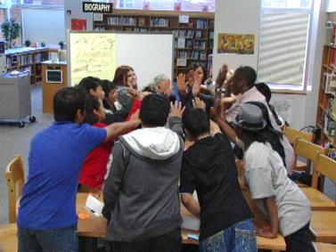
Academic Engagement
Sustained learning that involves students emotionally, cognitively, and behaviorally
Notes:
Tier 1 classroom practices are in service of academic engagement.
We know that when students are engaged in rich, culturally relevant, developmentally informed tasks, they are less likely to engage in unwanted behaviors.
This is why academic engagement is foundational to this work.

Slide 12
Universal Strategies
Meet & Greet
Reflect & Connect
Visual Postings
Turn & Talk
Clear Instructions
Behavior Check-In
Walk-Around Look-Fors (Formative Assessment)
Notes:
The Tier 1 strategies outlined here support an equity-centered learning environment.
These are universal strategies that promote positive behavior and engagement and prevent unwanted behavior and disengagement for each and every student.

Slide 13
Sample Table of Contents
Table of Contents in an Effective Code
Letter from the the Board and Superintendent Introduction (Equity Statement, Goals, Core Beliefs,Core Concepts, Mindsets) Rights and Responsibilities Universal Pre-K-12 Promotion and Prevention Classroom Strategies Discipline and Student Support Getting Help and Helping Others Other District-School Policies Definitions and Explanations
Notes:
This is a critical section of the Code.

Slide 14
The Disciplinary Response Cycle
Notes:
We know that even in a classroom where Tier 1 practices are being implemented by a skillful teacher, there will be student behaviors that require support outside the classroom.
Children and and adolescents will engage in unskillful and inappropriate behaviors; it is developmentally normal.
When this occurs, the student is supported by a structure called the Disciplinary Response Cycle.

Slide 15
Notes:
The Disciplinary Response Cycle is a school-wide set of standardized actions that take effect when a student’s unskillful, inappropriate, or unacceptable behaviors require attention, care, and support beyond the responses of the classroom teacher.
The Disciplinary Response Cycle provides a step-by-step process for administrators and other key staff members to engage in to support the student.
Standardizing this cycle across the district builds the efficacy of staff implementing the Disciplinary Response Cycle and ensures equitable treatment for all students.

Slide 16
Notes:
The second action in the Disciplinary Response Cycle is providing an Accountable Consequence – a disciplinary response that is a direct result of a student’s unskillful, inappropriate, or unacceptable behavior.
An accountable consequence that is fair, signals that adults are concerned about the student’s behavior and messages and supports the student to take responsibility for their actions.
Examples outlined here represent the consequence phase of the Disciplinary Response Cycle.

Slide 17
Notes:
The third action in the Disciplinary Response Cycle is providing a Restorative Intervention – a disciplinary response that empowers the student to:
Learn skills and target behaviors to improve their self-awareness, self-management, and social and academic efficacy.
Repair relationships and the harm they have done to others.
Restore their good standing in the community.
Revising a Code presents a district with the opportunity to ramp up the caliber of a set of standardized restorative interventions to be implemented in all schools throughout the district.
There are interventionists with expertise in districts: Social workers, school-based counselors, administrators, behavior specialists, and others.
Tapping into their expertise to both assess current restorative interventions and their impact, and visioning a set of interventions that would ensure building core target behaviors, skills and competencies is a critical piece of the Code revision/development process.

Slide 18
Notes:
The fourth action in the Disciplinary Response Cycle is Closing the Loop, which involves communicating with parents/caregivers and teachers to review actions taken, facilitate a re-entry conference, monitor student’s progress, and engage in follow-up support and interventions if appropriate.
This is ensures that the student will receive the wrap-around support needed for steady growth and development.
Some examples of key actions taken during this phase of the DRC include…

Slide 19
Notes:
Determining the right accountable consequence and restorative intervention is supported by a matrix - a section within the Code that guides staff to engage in a healthy and non-biased discussion to identify the level of consequence and intervention for a specific behavior violation.

Slide 20
Behavior Violations Matrix
Behavior Violation | Level 1 | Level 2 | Level 3 | Level 4 | Level 5 | Notes
Verbal Aggression
Cursing, swearing, use of insulting, defaming, vulgar or abusive language |  | ◾ | ◾
Verbal threats |  |  | ◾ | ◾ |  | The intensity of the threat needs to be considered when assigning the level. Includes written threats on paper, on school property, or in notes, texts, email, postings on Internet sites, or through other electronic mechanisms.
Notes:
The matrix is organized around behavior violations.
The behavior violation is in blue - alphabetized.
The level of consequences and interventions is in orange.
The explanatory information is in green.
The matrix narrows but does not completely limit discretion on an administrator’s part.
Administrators need to take into account the totality of the circumstances.
For example, verbal threats span levels 3 through 4 so that administrators can take into account such as intensity of threat and the age/developmental level of the student.

Slide 21
Sample Scenario
Behavior Violation | Level 1 | Level 2 | Level 3 | Level 4 | Level 5 | Notes
Verbal Aggression Towards Students
Cursing, swearing, use of insulting, defaming, vulgar or abusive language directed at students |  | ◾ | ◾
Accountable Consequences:
Referral with student removal
Meet with administrator
Administrative detention/ structured lunch
Teacher observation: A 7th grader called another student “a f***ing idiot.” The student has a complex profile and a significant history of verbal aggression. This was said in a loud and hostile tone and was very public. The teacher sent the student to the office and submitted a referral. Taking into account the totality of circumstances, including the age and developmental level of the student, the administrator, in consultation with a social worker, assigned a Level 3.
Restorative Interventions:
Restorative Conversation with the pair of students
Closing the Loop:
Parent/caregiver communication
Progress Monitoring/ CICO for three weeks
Notes:
This is an example when an administrator and/or student support staff member are critical to the Disciplinary Response Cycle.
The levels reduce discretion and support key staff to implement restorative, accountable, and equitable responses.
The example, where the violation could fall within level 2 or level 3, illustrates the flexibility of the Matrix. The administrator/staff member take into account the student’s developmental level and the totality of circumstances around the behavior, such as the frequency of the violation.
Administrators will work together to calibrate the Matrix and implement it with fidelity.

Slide 22
The Code Development Process
Notes:
Developing a Code of Character, Conduct, and Support is an intensive process and takes time, care, and a committed group of educators to vision the process for their district and all stakeholders.

Slide 23
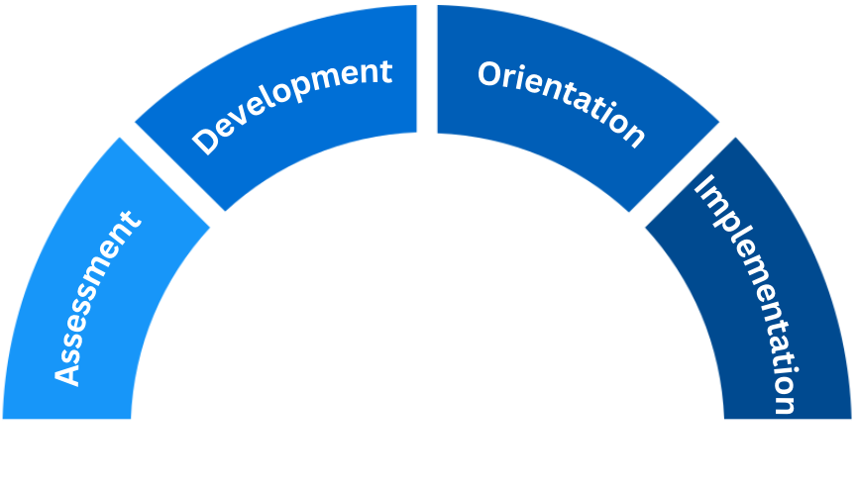
The Four Phases
2
3
1
Phases of the
Code of Character, Conduct, and Support
4

Slide 24
An Inclusive Process
Decision Makers
Superintendent
Content Creators and Champions
District Code Team
Task Force
Key Voices
School Board
School
Administrators
Teachers
Student Support Staff
Students
Parents/
Caregivers
Community Partners
School Code Implementation Teams
Notes:
Developing or revising a Code must be an inclusive process.
Strategically involving a number of stakeholders ensures that a representative number of voices are heard, and builds understanding, commitment, shared language, and accountability for this work.
It is about making sure everyone has a seat at the table, and that the Code meets the needs and interests of all stakeholders.
It is also about ensuring that once the Code goes into implementation, there are champions of the work in every corner of the district, and that the effort is sustained and implemented with fidelity.

Slide 25
Implementation and Impact
Notes:
An inclusive process ensures that the district publish a Code that has garnered the respect of educators, students, staff and parents/caregivers in the district.
To garner this respect and meet the goals of the Code requires an intentional plan for implementation and measuring impact and essential school-based teams that work interdependently..

Slide 26
The Three Pillars
Code Implementation
Teachers:
Promotion Prevention Practices
Student Support:
Restorative Interventions
School Leaders:
Disciplinary Response Calibration
Notes:
Three groups – teachers, student support staff, and school leaders – receive ongoing strategic professional learning to deepen understanding and build efficacy in their implementation efforts.

Slide 27
Implementation Impact
Notes:
Designing a Data Dashboard to measure progress on a Code’s goals is critical to monitoring the impact of the goals of the Code and providing direction on short term and long-term actions to be taken districtwide and at specific schools.
This data set is a snapshot of Lost Instructional Time and illustrates a reduction in 6,000 lost instructional days due to OSS from 2022 to 2023.

Slide 28
Code Implementation Data Patterns
Leading Indicators
Initial uptick in ODRs
Shift from long-term to short-term suspensions
Shift from OSS to ISS
Lagging Indicators
Reduction in repeat behavior violations
Reduction in disproportionality
Improvement in attendance and grades
Notes:
When a new Code is implemented, typically there are leading indicators, data points that shift early, and lagging indicators, data points that take more time to shift.
Early in implementation, there can be an uptick in office disciplinary referrals (ODRs) as a district standardizes its protocol for entering referrals – this isn’t an increase in incidents but an indicator that they are being more accurately captured.
Other shifts typically seen in early implementation:
a shift from long-term to short-term suspension, as the Code includes a structure for district oversight of suspensions longer than five days, as well as a shift from out of school to in-school suspension.
A key lagging indicator is a reduction in disproportionality, since this requires a shift in mindsets, which takes time.
It takes time to see a reduction in repeat behavior violations, since this requires training and implementation of restorative interventions in all schools.
Another data point that takes time to shift is typically attendance and grades, since this requires the shifts in discipline and student support, and instruction to lead to a shift in school culture.
There is an urgency in districts to improve student outcomes, and it is critical to stay the course and understand systems change requires time before we see a complete shift in the data.

Slide 29
Entry Points to the Work
Districtwide Code Development
Teachers: Universal Strategies
Student Support: Restorative Interventions
Focus on Individual Schools or Grade Spans
Notes:
Some districts find developing or revising a current Code of Conduct to be too big of an effort to start with.
There are other entry points in reducing disproportional discipline practices and increasing equitable classroom and school-wide practices that will support the growth and development of each and every student.
Larry: There were no talking points on this slide. Do these make sense? YES, THESE MAKE SENSE

